Slide 1
File in the h le!
File Uploaders Vulnerabilities
HackPra November 2012
Soroush Dalili
SecProject.com

Slide 2
About Me – Soroush Dalili
Web Application Security Researcher since 2006
Finding vulnerabilities in my spare time:
IIS Semi-Colon Problem, IIS ShortFile Scanner, ...
My blog: http://soroush.secproject.com/blog/
Twitter: @IRSDL
Email: IRSDL at Yahoo dot com

Slide 3
Topic: Security of File Uploaders
Introduction to Form-based File Upload
File Upload Vulnerabilities
Protections and Bypass Methods
Bonus zero days in examples!

Slide 4
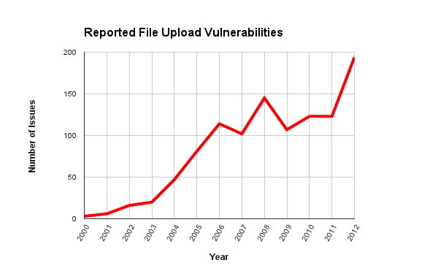
Reported File Upload Vulnerabilities
Based on: http://osvdb.org , Keyword: File Upload
More info: http://goo.gl/NmxpM
Notes:
Reported File Upload Vulnerabilities

Slide 5
What can hackers do?
Direct File system access and RCE
Placing backdoors or making it more vulnerable
Exploiting Local File Inclusion issues
Exploiting server side libraries
Exploiting server side monitoring tools
Uploading phishing pages
Hosting dangerous and/or malicious files
Hosting illegal contents
Denial of Service by consuming the resources
Denial of Service by manipulating the files
Damaging website reputation
…
Notes:
- File system access and remote command/code execution - Damaging website reputation by defacing it or uploading inappropriate contents - Making a website vulnerable to the other types of attacks such as XSS - Creating an arbitrary file to exploit local file inclusion vulnerability - Exploiting vulnerable file monitoring tools such as AntiVirus - Exploiting vulnerable libraries such as image or compression library - Creating phishing forms to steal users data - Dangerous files can be executed by other users/applications that have access to the server - Server can be used to store malwares, illegal software, steganographic objects, and so on - Can lead to Denial of Service by consuming the server’s space resource - Can lead to Denial of Service by creating invalid system files (web.config or .htaccess and so on...)

Slide 6
Web Based File Upload
Easy way to put the files on the server
Increase business efficiency
Uses a simple web browser
Sharing photos, videos, files, and so on
Being used in most of the modern websites:
Social Networks, Mail Systems, Shops, Content Management Systems, Forums, …

Slide 7
Client Side File Upload Methods
The most common:
Form-based File Upload in HTML (RFC 1867)
Post Method
Content-Type (enctype) = multipart/form-data
Others:
PUT HTTP Method
ActiveX
Java Applets
…
Notes:
There are different methods to upload a file into a server such as using PUT method, ActiveX, Java Applet, and so on. The most common method however, is using Multipart/Form-Data in a HTML form with POST method.
PUT - POST Request... We will discuss Multi-Part Post request because of the following reasons http://www.elharo.com/blog/software-development/web-development/2005/12/08/post-vs-put/ http://geekswithblogs.net/narent/archive/2008/01/04/118224.aspx Firewalls restriction Sending multiple inputs Browsers Limitation (http://stackoverflow.com/questions/2277423/put-request-turns-into-get)

Slide 8
File Upload – Simple Form
<form method="post" enctype="multipart/form-data" action="upload.aspx">
File Name: <input type="file" name="myfile" />
<input type="submit" value="Upload" />
</form>

Slide 9
Simple Form - Client Sends…
POST /samples/upload.aspx HTTP/1.1
Host: www.example.com
Content-Type: multipart/form-data; boundary=AB12
Content-Length: 1337
--AB12
Content-Disposition: form-data; name="myfile"; filename="test.txt"
Content-Type: text/plain
File Contents ...
--AB12--
RFC 1867
Notes:
http://www.ietf.org/rfc/rfc1867.txt
A boundary is selected that does not occur in any of the data. (This selection is sometimes done probabilisticly.)
Name= HTML Field Name
Filename= Original Filename + Path
Second content-type: File’s content type
Encoding can be based on http://tools.ietf.org/rfc/rfc1522.txt

Slide 10
File Uploaders Vulnerabilities
Specific Issues:
Improper or no access control
Arbitrary (Unrestricted) File Upload
Overwriting critical files
Path disclosure
Directory Traversal
Insecure Temporary File
+ Other web application vulnerabilities
Notes:
File Uploaders are normal web applications; therefore, they can be vulnerable to any web application vulnerabilities such as: Arbitrary (Unrestricted) File Upload
Lack of proper access control
Improper validation
Misconfiguration
Insecure Temporary File
Overwriting Critical files
CSRF
File/Path disclosure
XSS
SQL Injection
And so on

Slide 11
Improper Or No Access Control
Group A:
Admin level access needed (Specific users which have been authorised by admin)
Authentication bypass vulnerabilities…
Client Side Attacks… CSRF , XSS
Group B:
No authentication needed
Normal user can have access
“All the options are on the table!”
Notes:
Group A: Plugin upload section of Jira
Group B: uploading avatars, photos, or in editors such as FCKEditor

Slide 12
Real Example: Access Control
External module/library, it is safe: Wrong!
It is just an editor: Wrong!
Bunch of images are harmless: Wrong!
In-house applications are more vulnerable.
Published vulns. in public apps:
Year | OSVDB.org Records
2012 | 194
2011 | 123
2010 | 123
2009 | 107
2008 | 145

Slide 13
Arbitrary (Unrestricted) File Upload
Restricted File Upload:
Validation or other protections
Can be bypassed?
Unrestricted/Unprotected file upload:
You can upload whatever you want!
And NO access control?
Piece of cake!

Slide 14
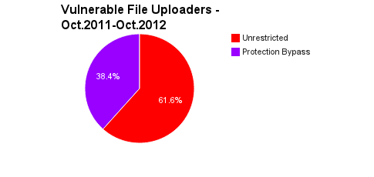
Real Example: Arbitrary (Unrestricted) File Upload
Based on: http://exploit-db.com – total: 74 items
More info: http://goo.gl/NmxpM
Notes:
These are exploitable ones

Slide 15
Overwriting Sensitive Files
Changing the functionality
Bypassing the protections
Make the website vulnerable
Denial of Service! Lame but possible
→Famous sensitive files:
.htaccess, web.config, crossdomain.xml,
clientaccesspolicy.xml, global.asa, golbal.asax

Slide 16
Real Example: Overwriting Sensitive Files
Exploit-DB ID: 17644
FCKeditor (Old Version) Protection bypass by uploading a .htaccess file
Even x_test.gif could run as a php file!
Better Exploitation:
Running a shell inside the .htaccess file
By “Eldar Marcussen” - http://www.justanotherhacker.com
Notes:
http://www.justanotherhacker.com/2011/05/htaccess-based-attacks.html

Slide 17
Path Disclosure
Included libraries are not always safe
File system and webserver are important
Different method for path disclosure:
File/Directory/Symlink already exists
Filename is too long
NTFS: 255 characters
Forbidden characters or reserved words
WinOS: “<>?|:*"” + Control Characters
WinOS: CON, NUL, COM1, …
Sensitive file system patterns
NTFS ADS: “:$I30:$INDEX_ALLOCATION” or “::$BITMAP”
Permission Denied
Notes:
http://en.wikipedia.org/wiki/Comparison_of_file_systems
http://msdn.microsoft.com/en-gb/library/windows/desktop/aa363911(v=vs.85).aspx

Slide 18
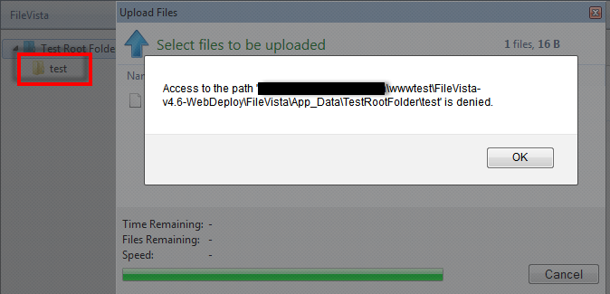
Real Example: Path Disclosure
GleamTech FileVista v4.6:
Uploading “test” as a file when we have a directory with the same name:

Slide 19
Tip: Create a Folder by File Upload!
NTFS ADS:
FolderName::$Index_Allocation
Or
FolderName:$I30:$Index_Allocation
Short Demo: File - YouTube

Slide 20
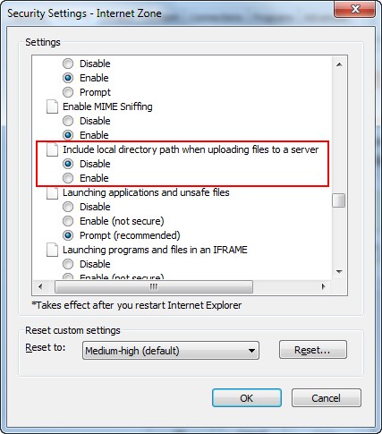
Directory Traversal
Modern browsers hide the local path:
Note: Anything before the last “/” or “\” in filename is usually ignored by the web application
but it needs to be tested!

Slide 21
…Directory Traversal
Usually File Uploaders have destination parameter(s)!
Can accept an absolute path? Try these:
“C:\”, “\\127.0.0.1\c$\”, “file:///c:\\”, “\\.\GLOBALROOT\Device\HarddiskVolume1\”, “\\?\localhost\c$\”
Is it a relative path?
“../”, “..\”, with URL encoding, double URL encoding, or Unicode encoding
Other tricks (Code/FS dependent)
Dot or Space after filename in windows
Incorrect protections: Example: replacing “../” with nothing
Notes:
https://www.owasp.org/index.php/Testing_for_Path_Traversal_(OWASP-AZ-001)

Slide 22
Real Example: Directory Traversal
GleamTech FileVista v4.6:
Bypassing protections for “../” & “..\” by using:
“.. /” (“..%20/”) & “.. \” (“..%20\”)
Short Demo: File - YouTube

Slide 23
Insecure Temporary File
Accessible via web directly?
Examples:
Mail attachments: Upload, Download
Data Processing : e.g. resizing an image
PHP temp files on File Upload

Slide 24
Real Example: Insecure Temp File
Old but still effective for some systems…
SmarterMail File Upload Vulnerability:
Temp Uploaded ASP file
Link: http://securitytracker.com/id/1013021
MailSite Express File Upload Vulnerability:
Temp Uploaded and then viewed file
Link: http://securitytracker.com/id?1015063

Slide 25
Other Vulnerabilities
Similar to other Web Apps Vulns…
Impacts can be highly critical though!
e.g.:
Cross Site Request Forgery
Upload a file on behalf of authorities
Cross Site Scripting
Can make a website vulnerable OR can be vulnerable itself!
SQL Injection
When the website uses a database system
Denial of Service
Consuming server’s hard drive? Processing a large image?
And so on…

Slide 26
Protection Methods
Client Side Protections: Name and Extension
It only makes the website more user friendly.
It is not for security!
Data can be manipulated by a web proxy as usual
Server Side Protections – Proper ones!
Inside the code (Internal)
Outside the code (External)
Notes:
Can only see File Name and Extension.
Limited Browsers can use “accept”(content-type)

Slide 27
Common Protection Methods
Internal | External
Content-Type (mime-type) | Firewall: Request Header Detection
File Name and Extension | Firewall: Request Body Detection
File Header (File Type Detector) | Web Server Configurations
Content Format | Permissions on File system
Compression (Image) | Antivirus Application
Name Randomization | Storing data in another domain
Storing files out of accessible web directory
Storing files in the database
Notes:
Client Side Protections: These protections can be simply bypassed. Client side validation only is being used to help users! It does not provide any security.
Web Server: .htaccess, web.xml, ApplicationHost.config, Web.config
Whitelist Blacklist Others: Encoding/Compression/Permission

Slide 28
Bypassing Firewalls: Intro
Good to have it. But, no matter how good it is, it can be bypassed:
Different implementations of RFCs in web servers. e.g.:
Using white space characters and CrLf in HTTP Header
Using Multiple fake “Boundary” items
Using “Transfer-Encoding: chunked” and obfuscating the body
Different File Systems/Operating Systems features. e.g.:
“test.aspx” = “test~1.asp” in Windows which supports 8.3
Different web technologies features. e.g.:
PHP converts “.” to “_” in the parameter name
ASP converts certain UTF-8 characters to ASCII
Notes:
http://tweakimg.net/files/upload/wafblackhat.pdf
http://www.coresecurity.com/files/attachments/Windows%20File%20Pseudonyms%20Dan%20Crowley%20Shmoocom%202010.pdf

Slide 29
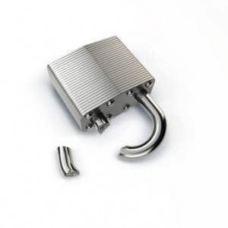
Bypassing Web Server Configs.
.htaccess, web.config, and so on:
Overwrite their contents
Create a new one in a new folder
Use Windows 8.3 file names
Other webserver configurations
Use extensions that are not being blocked
asa, cer, php3, php4, ashx, pl, cgi, shtml, phtml, …
Try path traversal to move the uploaded file
Notes:
Many webservers protect themselves by using config files.

Slide 30
Bypassing FS Permissions
We don’t need bypass for file upload
Write access in Upload directory is needed
Webserver needs to be configured not FS
Not having execute permission does not help!
Write permission can be prohibited outside
What about Temp/Real Time files/folders?
Still bad if you can upload arbitrary files
It is good to have this to reduce the risk

Slide 31
Bypassing Antivirus Application
AV only blocks malwares/viruses
Web-shell can be obfuscated
AV vulnerabilities can be exploited:
e.g.: Sophos Vulnerabilities by Tavis Ormandy:
7th Nov 2012: http://secunia.com/advisories/51156/
Just upload a file to execute your code
In PHP, you just need to send your file to any PHP file!

Slide 32
Storing Data on Another Domain
Good solution, hard implementation
File Server must be isolated
File Server must be hardened
Subdomain can still be dangerous
Reading/Setting cross subdomain cookies
e.g.: “domain=.example.com”
Phishing attacks

Slide 33
Content-Type Protection Issues
Location in the request:
File extension will change the “Content-Type”
Can be easily manipulated by a web-proxy
Mostly image uploaders are the victims
“Do Not Trust/Use Content-type!”

Slide 34
Real Example: Content-Type Bypass
ManageEngine Support Center Plus:
Exploit-DB ID: 22040
Bypass = “Content-Type: image/gif”
MobileCartly 1.0:
Exploit-DB ID: 20539
Bypass = “Content-Type: image/gif”…

Slide 35
Name and Extension Issues
First Step: What is File Extension in “test.php.jpg”?
“.php.jpg”?
“.jpg”
Next Step: Which part has validation?
Filename or Extension or Both?
What does it do with existing files?
Logical flaws
Denial of Service …

Slide 36
1- Missed Extensions – Got u!
White-list or Black-list?
Check executable extensions
“.php” is blocked, what about “.php3”, “.php4”, “.phtml”, etc?
“.asp” is blocked, what about “.asa” or “.cer”?
What about client side extensions?
.htm, .html, .swf, .jar, …?

Slide 37
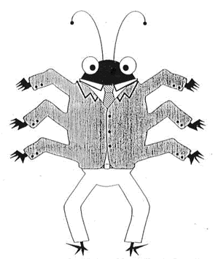
2- Double Extensions – Featur3s!
The most common bypass method in 2012!
Webserver related (can be fixed in Apache)
Apache common configuration:
“file.php.jpg” served as PHP
“AddHandler application/x-httpd-php .php”
Better solution:
IIS 6 useless feature:
“file.asp;.jpg” → run as an ASP file
“/folder.asp/file.txt” → run as an ASP file
Notes:
AddHandler application/x-httpd-php .php
Should be
<FilesMatch \.php$>
SetHandler application/x-httpd-php
</FilesMatch>

Slide 38
3- Case Sensitive Rules? – Easy on3!
Normally when we have Regular Expressions
Always try it!
Code Example:
Blacklist RegEx: “^\.php$”
“file.php” != “file.PhP”
“file.php3.jpg” != “file.PHP3.JpG”
Example: eFront
Exploit-DB ID: 18036

Slide 39
4- Windows 8.3 – I <3 Featur3s ☺
Overwriting sensitive files is easy:
“web.config” == “WEB~1.con”
“default.aspx” == “DEFAUL~1.asp”
Files without extensions are allowed?
“.htaccess” == “HTACCE~1”

Slide 40
5- Windows File System – Oh, OK!
End of filename - ignored characters:
Trailing dot and space characters
“test.asp … . .. .” == “test.asp”
Sometimes when it saves a file:
“test.php<>” == “test.php”
NTFS Alternate Data Streams:
“file.asp::$data” == “file.asp”
“/folder:$i30:$Index_allocation” == “/folder”
“.htaccess:.jpg” → make empty “.htaccess” == “HTACCE~1” …

Slide 41
6- Null Character – S3cr3t Warr1or!
“file.php%00.jpg”
It needs to be decoded
Web server (name is in URL or code has URLDecode)
From client in “filename” section
Depends on server side parser

Slide 42
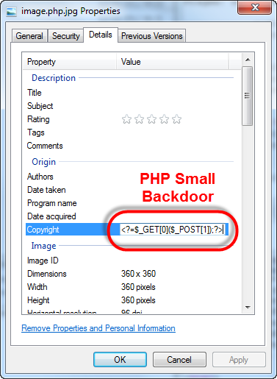
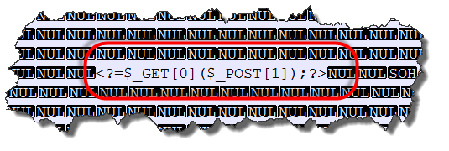
File Type Detector Issues
Height/Width of image files?
Simple Example: Comments in a jpeg file:

Slide 43
Content Format Issues
Detecting malicious code by using a pattern?
Too many vectors and obfuscation techniques
False/Positives
Binary files
Different encodings
Performance issue
“This protection method is vulnerable!”

Slide 44
Compression (Image) Issues
Does it remove the meta-data?
Always scrambles the input?
What about small data?
Malicious code can be produced by the compression out of dust!
Source: http://www.idontplaydarts.com
A compressed .png file can contain PHP code!
PNG Image
Compression
PNG with PHP code!

Slide 45
GZIP Compression → PHP Code
Harmless Text…
Gzip Compression:
Now, we have a PHP backdoor:
<?=$_GET[0]($_POST[1]);?>

Slide 46
Name Randomization Issues
What about Extensions? Double Extension?
Randomization Algorithm
Predict the names (when file is hidden)
Does it use original name?
Causing error by invalid characters
Long strings can cause delays

Slide 47
Out of Web Folder Issues
Directory Traversal to make it accessible?
Remember FileVista Issue?
Still can be used in LFI
How will users see them?
You need to proxy them
Performance issue
Local File Disclosure by a Directory Traversal
Loading unauthorized contents/files
Local/Remote file inclusion issue
And so on

Slide 48
Files In the Database Issues
SQL Injection
Still can create temporary files
Performance
In upload and download
Files in the database need more space
Can lead to DoS
What if you want to migrate to another app?

Slide 49
Logical/Programming Flaws!
File duplication issues
Delay problems
Good for LFI and DoS!
Special file formats
Compressed files
XML files
Bad programming
Using “include” function to show an image
Replacing bad characters/extensions with nothing:
“file.p.phphp” → “file.php”
And so on

Slide 50
Other Interesting Vectors Examples
In Apache (if we are in “/www/uploads/” dir):
Tested in Windows:
filename = “.” or “…”→ make “/www/uploads” file
In NTFS, “…:.jpg” makes “…” file
Removable only via command line: “del *.*”
By misconfiguration, “file.jpg” can run as PHP:
“/file.jpg/index.php”, check this too!
Notes:
https://nealpoole.com/blog/2011/04/setting-up-php-fastcgi-and-nginx-dont-trust-the-tutorials-check-your-configuration/

Slide 51
w3Schools Example is vulnerable!
Many developers use it as a base! O_0
The issues are:
It uses “Content-Type” as well as the extension!
No protection for double extensions
Possible Cross Site Scripting
Cross Site Request Forgery
Lack of authentication
Other online examples have similar issues

Slide 52
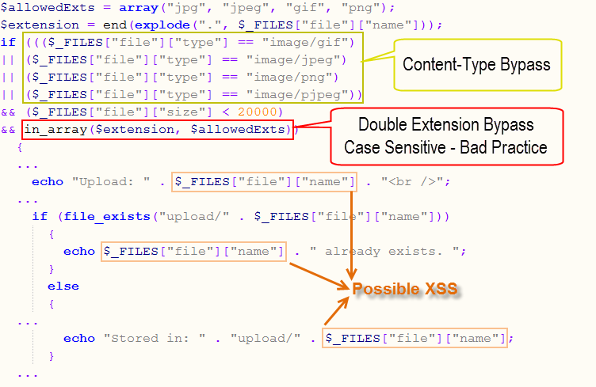
w3Schools Example is vulnerable!

Slide 53
FCKEditor 2.6.8 File Upload Issue
“.asptxt” is a valid extension
Dangerous characters are converted to “_”
However, file duplication is an exception!
Thanks to Mostafa Azizi (@0daynet) for this bug
“file.asp;txt” → will be saved as “file.asp_txt”
Again “file.asp;txt” → will be saved as “file(1).asp;txt” → IIS6 useless feature shines!
But, we can even use Null Character here to have “file(1).asp” on the server!
Short Demo: File - YouTube

Slide 54
CKFinder/FCKEditor DoS Issue
There is a logical flaw in CKFinder ASP version.
Uploading “Con.pdf.txt” kills the server:
CKFinder renames an existing file to “file(1).ext”
If “file(1).ext” was taken, it will try “file(2).ext”, and so on
CkFinder is OK with multiple valid extensions
“CON” is a forbidden name in Windows
CKFinder thinks “Con.pdf.txt” is taken,
It tries “Con.pdf(1).txt” which is forbidden too!
“Con.pdf(2).txt” … “Con.pdf(MaxInt).txt”
This can kill the server!

Slide 55
Quick checklist…
Do you have enough internal and external protections?
Are they bypassable? Try it yourself!
Can you host malwares, adult or illegal content for free?!
Do you have a monitoring system to report newly uploaded/modified files?
Are all the libraries and modules up to date?
Upload a safe webshell and try to see how much access it has!

Slide 56
File Managers Modules
File Managers include different modules:
Upload File
Create File/Directory
Edit File
Rename File/Directory
Delete File/Directory
Move File/Directory
Compress/Decompress Modules
Image converting/resizing modules
Download/View File
Browse Files/Directories
Change Permissions
More functionality → Possibility of more vulnerability

Slide 57
Future Works…
Attack vectors cheat sheets
Protection methods cheat sheets
More OWASP ESAPI for file managers
Payloads to make the testing automatic
Better checklists for Web Developers & Webmasters.

Slide 58
Question time… - Yay! Fin4lly!
Any Question?

Slide 59
Thank You!
A BIG thank you to everyone
And, to the people who helped me to prepare this talk.
Here are my contact details:
Twitter: @IRSDL
Email: IRSDL at Yahoo dot com

